Slide 1
Review: Design Eq & Conversion
ν_{j}≡ stoichiometric coefficient; positive for products, negative for reactants
BATCH
SYSTEM:
Ideal Batch Reactor Design Eq with X_{A}:
FLOW
SYSTEM:
Ideal CSTR Design Eq with X_{A}:
Ideal SS PFR Design Eq with X_{A}:
Ideal SS PBR Design Eq with X_{A}:

Slide 2
Review: Sizing CSTRs
We can determine the volume of the CSTR required to achieve a specific conversion if we know how the reaction rate r_{j} depends on the conversion X_{j}
Ideal SS CSTR design eq.
Volume is product of F_{A0}/-r_{A} and X_{A}
Plot F_{A0}/-r_{A} vs X_{A} (Levenspiel plot)
V_{CSTR} is the rectangle with a base of X_{A,exit} and a height of F_{A0}/-r_{A} at X_{A,exit}

Slide 3
Review: Sizing PFRs & PBRs
We can determine the volume (catalyst weight) of a PFR (PBR) required to achieve a specific X_{j} if we know how the reaction rate r_{j} depends on X_{j}
Ideal PFR design eq.
Ideal PBR design eq.
Plot F_{A0}/-r_{A} vs X_{A} (Experimentally determined numerical values)
V_{PFR} (W_{PBR}) is the area under the curve F_{A0}/-r_{A} vs X_{A,exit}
Area = V_{PFR} or W_{catalyst, PBR}

Slide 4
Numerical Evaluation of Integrals (A.4)
Trapezoidal rule (2-point):
Simpson’s one-third rule (3-point):
Simpson’s three-eights rule (4-point):
Simpson’s five-point quadrature :

Slide 5
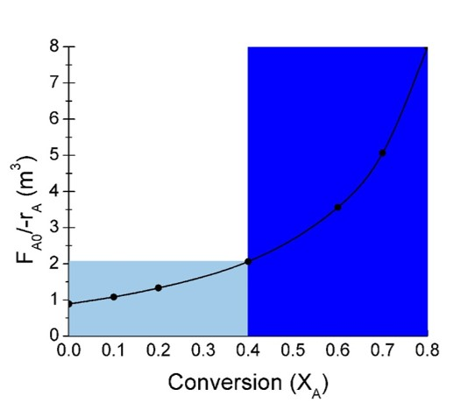
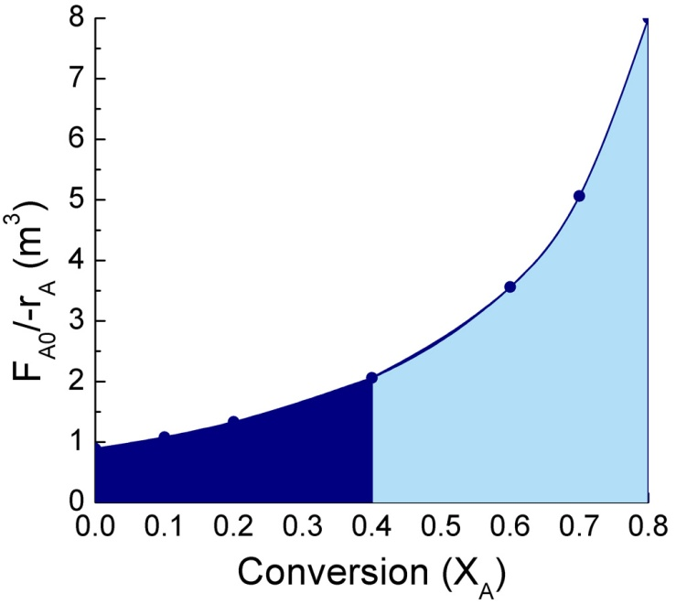
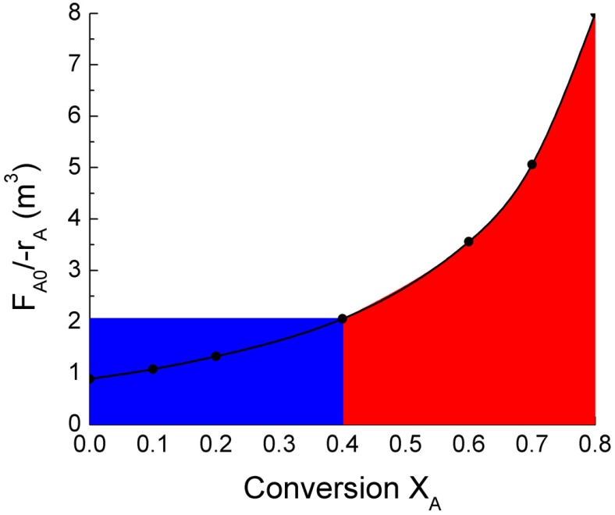
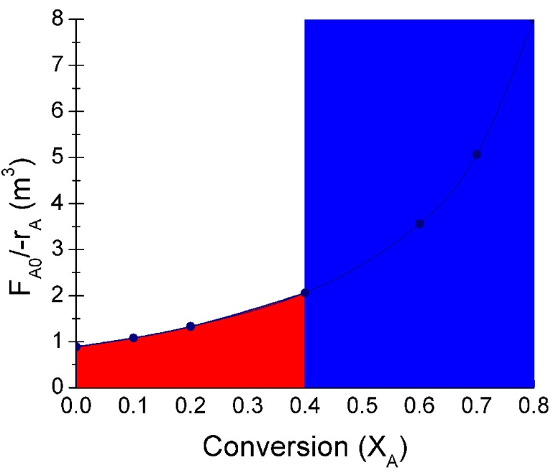
Review: Reactors in Series
If is monotonically
increasing then:
2 CSTRs
2 PFRs
V_{CSTR2}
V_{CSTR1}
V_{PFR1}
V_{PFR2}
CSTR→PFR
PFR→CSTR
V_{CSTR1} + V_{PFR2}
≠
V_{PFR1} + C_{CSTR2}
V_{CSTR2}
V_{CSTR1}
V_{PFR2}
V_{PFR1}

Slide 6
Chapter 2 Examples

Slide 7
Calculate the reactor volumes for each configuration shown below for the reaction data in the table when the molar flow rate is 52 mol/min.
-r_{A} is in terms of mol/dm³∙s
F_{A0}, X₀
X₁=0.3
X₁=0.3
X₂=0.8
F_{A0}, X₀
X₂=0.8
Config 1
Config 2
X_{A} | 0 | 0.1 | 0.2 | 0.3 | 0.4 | 0.5 | 0.6 | 0.7 | 0.8 | 0.85
-r_{A} | 0.0053 | 0.0052 | 0.0050 | 0.0045 | 0.0040 | 0.0033 | 0.0025 | 0.0018 | 0.00125 | 0.001
←Use numerical methods to solve
X_{A,out} and X_{A,in} respectively, are the conversion at the outlet and inlet of reactor n
1. Calculate F_{A0}/-r_{A} for each conversion value in the table
F_{A0}/-r_{A}
Convert to seconds→

Slide 8
Calculate the reactor volumes for each configuration shown below for the reaction data in the table when the molar flow rate is 52 mol/min.
-r_{A} is in terms of mol/dm³∙s
F_{A0}, X₀
X₁=0.3
X₁=0.3
X₂=0.8
F_{A0}, X₀
X₂=0.8
Config 1
Config 2
X_{A} | 0 | 0.1 | 0.2 | 0.3 | 0.4 | 0.5 | 0.6 | 0.7 | 0.8 | 0.85
-r_{A} | 0.0053 | 0.0052 | 0.0050 | 0.0045 | 0.0040 | 0.0033 | 0.0025 | 0.0018 | 0.00125 | 0.001
F_{A0}/-r_{A} | 164
←Use numerical methods to solve
X_{A,out} and X_{A,in} respectively, are the conversion at the outlet and inlet of reactor n
1. Calculate F_{A0}/-r_{A} for each conversion value in the table
Convert to seconds→
164
164

Slide 9
Calculate the reactor volumes for each configuration shown below for the reaction data in the table when the molar flow rate is 52 mol/min.
-r_{A} is in terms of mol/dm³∙s
F_{A0}, X₀
X₁=0.3
X₁=0.3
X₂=0.8
F_{A0}, X₀
X₂=0.8
Config 1
Config 2
X_{A} | 0 | 0.1 | 0.2 | 0.3 | 0.4 | 0.5 | 0.6 | 0.7 | 0.8 | 0.85
-r_{A} | 0.0053 | 0.0052 | 0.0050 | 0.0045 | 0.0040 | 0.0033 | 0.0025 | 0.0018 | 0.00125 | 0.001
F_{A0}/-r_{A}
←Use numerical methods to solve
X_{A,out} and X_{A,in} respectively, are the conversion at the outlet and inlet of reactor n
1. Calculate F_{A0}/-r_{A} for each conversion value in the table
Convert to seconds→
For each –r_{A} that corresponds to a X_{A} value, use F_{A0} to calculate F_{A0}/-r_{A} & fill in the table
164
164

Slide 10
Calculate the reactor volumes for each configuration shown below for the reaction data in the table when the molar flow rate is 52 mol/min.
-r_{A} is in terms of mol/dm³∙s
F_{A0}, X₀
X₁=0.3
X₁=0.3
X₂=0.8
F_{A0}, X₀
X₂=0.8
Config 1
Config 2
X_{A} | 0 | 0.1 | 0.2 | 0.3 | 0.4 | 0.5 | 0.6 | 0.7 | 0.8 | 0.85
-r_{A} | 0.0053 | 0.0052 | 0.0050 | 0.0045 | 0.0040 | 0.0033 | 0.0025 | 0.0018 | 0.00125 | 0.001
F_{A0}/-r_{A} | 164 | 167 | 173 | 193 | 217 | 263 | 347 | 482 | 694 | 867
←Use numerical methods to solve
X_{A,out} and X_{A,in} respectively, are the conversion at the outlet and inlet of reactor n
1. Calculate F_{A0}/-r_{A} for each conversion value in the table
Convert to seconds→

Slide 11
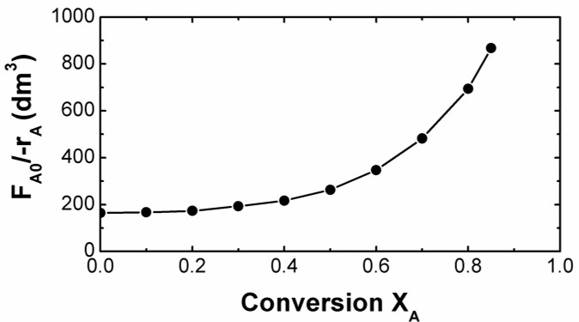
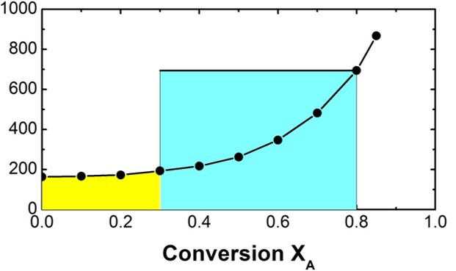
X_{A} | 0 | 0.1 | 0.2 | 0.3 | 0.4 | 0.5 | 0.6 | 0.7 | 0.8 | 0.85
-r_{A} | 0.0053 | 0.0052 | 0.0050 | 0.0045 | 0.0040 | 0.0033 | 0.0025 | 0.0018 | 0.00125 | 0.001
F_{A0}/-r_{A} | 164 | 167 | 173 | 193 | 217 | 263 | 347 | 482 | 694 | 867
F_{A0}, X₀
X₁=0.3
X₂=0.8
Config 1
Reactor 1, PFR from X_{A0}=0 to X_{A}=0.3:
PFR1
CSTR2
←Use numerical methods to solve
4-pt rule:
Total volume for configuration 1: 51.6 dm³ + 347 dm³ = 398.6 dm³ = 399 dm³

Slide 12
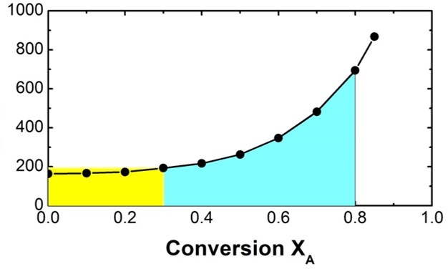
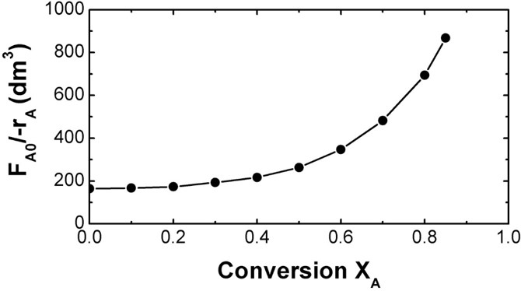
X_{A} | 0 | 0.1 | 0.2 | 0.3 | 0.4 | 0.5 | 0.6 | 0.7 | 0.8 | 0.85
-r_{A} | 0.0053 | 0.0052 | 0.0050 | 0.0045 | 0.0040 | 0.0033 | 0.0025 | 0.0018 | 0.00125 | 0.001
F_{A0}/-r_{A} | 164 | 167 | 173 | 193 | 217 | 263 | 347 | 482 | 694 | 867
F_{A0}, X₀
X₁=0.3
Must evaluate as many pts as possible when the curve isn’t flat
X₂=0.8
Config 2
Reactor 1, CSTR from X_{A0}=0 to X_{A}=0.3:
CSTR1
PFR2
Need to evaluate at 6 pts, but since there is no 6-pt rule, break it up
3 point rule
4 point rule
Total volume for configuration 2: 58 dm³ + 173 dm³ = 231 dm³

Slide 13
For a given C_{A0}, the space time τ needed to achieve 80% conversion in a CSTR is 5 h. Determine (if possible) the CSTR volume required to process 2 ft³/min and achieve 80% conversion for the same reaction using the same C_{A0}. What is the space velocity (SV) for this system?
τ=5 h
X_{A}=0.8
υ₀=2 ft³/min
Space velocity:
Notice that we did not need to solve the CSTR design equation to solve this problem.
Also, this answer does not depend on the type of flow reactor used.

Slide 14
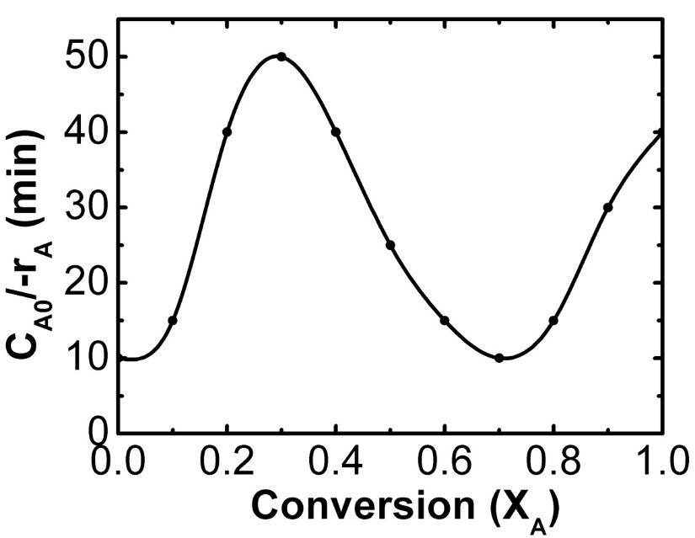
A product is produced by a nonisothermal, nonelementary, multiple-reaction mechanism. Assume the volumetric flow rate is constant & the same in both reactors. Data for this reaction is shown in the graph below. Use this graph to determine which of the 2 configurations that follow give the smaller total reactor volume.
X₁=0.3
F_{A0}, X₀
X₁=0.3
F_{A0}, X₀
X₂=0.7
X₂=0.7
Config 1
Config 2
Shown on graph
Since υ₀ is the same in both reactors, we can use this graph to compare the 2 configurations
PFR- volume is υ₀ multiplied by the area under the curve between X_{A,in} & X_{A,out}
CSTR- volume is υ₀ multiplied by the product of C_{A0}/-r_{A,outlet} times (X_{A,out} - X_{A,in})

Slide 15

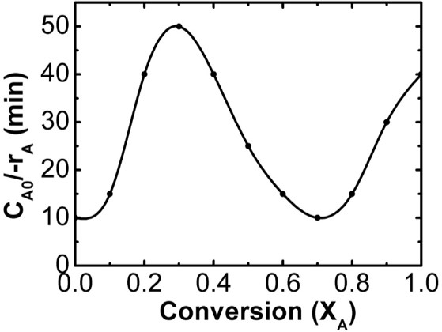
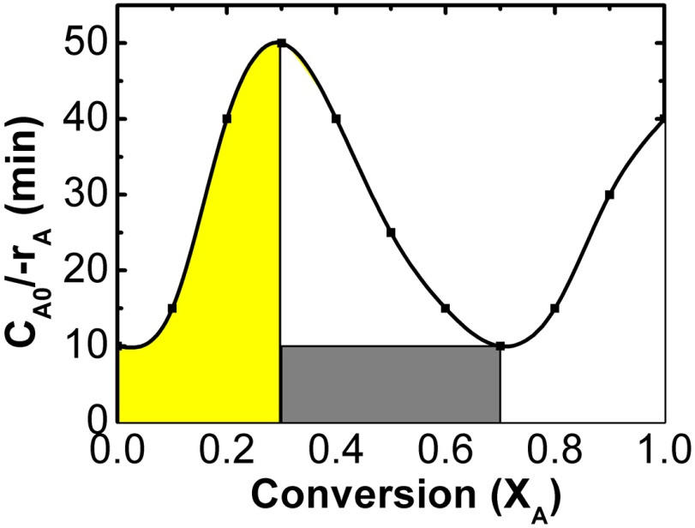
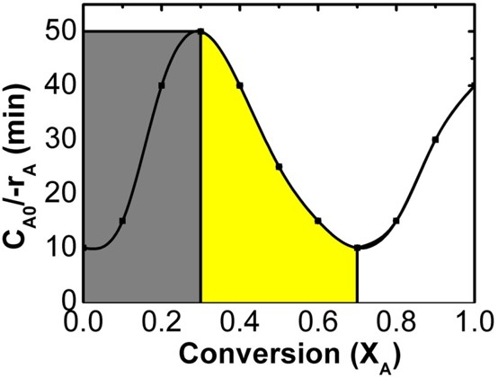
A product is produced by a nonisothermal, nonelementary, multiple-reaction mechanism. Assume the volumetric flow rate is constant & the same in both reactors. Data for this reaction is shown in the graph below. Use this graph to determine which of the 2 configurations that follow give the smaller total reactor volume.
X₁=0.3
F_{A0}, X₀
X₁=0.3
F_{A0}, X₀
X₂=0.7
X₂=0.7
Config 1
Config 2
Config 1
Config 2
X_{A} = 0.7
X_{A} = 0.7
X_{A} = 0.3
X_{A} = 0.3
PFR- V is υ₀ multiplied by the area under the curve between X_{A,in} & X_{A,out}
CSTR- V is υ₀ multiplied by the product of C_{A0}/-r_{A,outlet} times (X_{A,out} - X_{A,in})
Less shaded area
Config 2 (PFR_{XA,out=0.3} first, and CSTR_{XA,out=0.7} second) has the smaller V_{Total}

